Slide 1
EEG classification of ADHD patients with Mutual Information and Graph Neural Network
Yongjun Lee, Harun Pirim

Slide 2
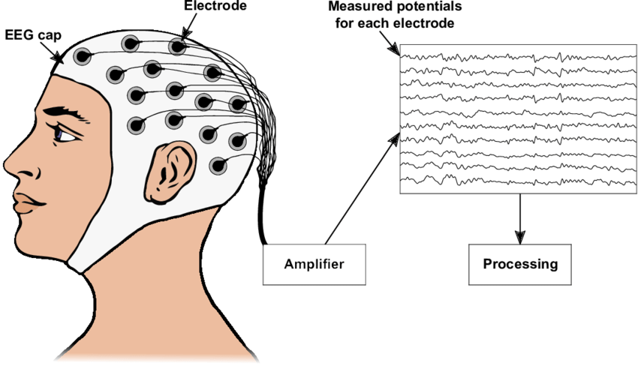
Background
What is EEG?
Electroencephalogram
Test that records brain activity with metal electrodes
Use Cases
BMI
Robot prosthetics
Mental illness research

Slide 3
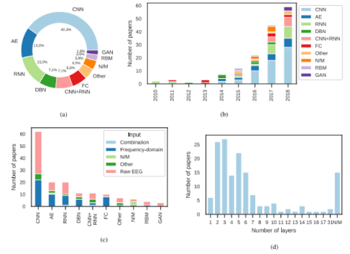
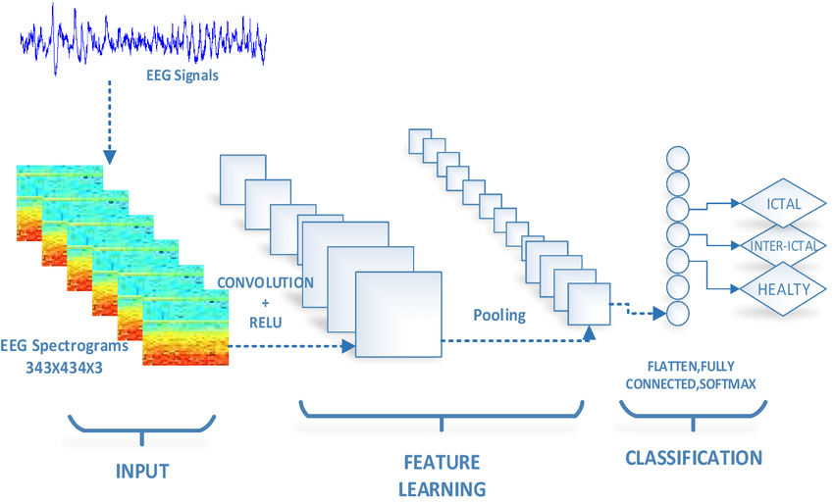
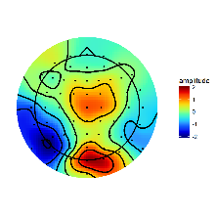
Background
What is EEG?
Deep Learning in EEG.
CNN is most widely used for EEG research
Notes:
Convolutional Neural Network has been one of the most popular deep learning model. Suited best for image processing tasks. It has been applied to EEG research Color mapping EEG data.

Slide 4
Background
What is EEG?
Deep Learning in EEG.
CNN is most widely used for EEG research
“Black Box” problem.
“the describing of raw EEG data without a theory driven study and standardized protocol, is problematic. It is possible that this approach is inhibiting the development of useful information regarding this potentially valuable method to aid diagnosis.”
- Adamou1 et al.
Notes:
Convolutional Neural Network has been one of the most popular deep learning model. Suited best for image processing tasks. It has been applied to EEG research Color mapping EEG data.

Slide 5
Background
What is EEG?
Deep Learning in EEG.
Graph Neural Network
GNN suits EEG dataset more naturally.
Better performance, interpretability.

Slide 6
Related Work
Proposed model from “A deep learning framework for identifying children with ADHD using an EEG-based brain network”
MI + CNN
Demir et al. reviewed six GNN models and benchmarked their performance for EEG classification task.
GraphSAGE, Graph Isomorphism Network (GIN), SortPool, EdgePool, SagPool, Set2Set
Notes:
Other models that use mutual information?

Slide 7
Method Overview
Create Graph Dataset
GNN Model
Predict / Interpret
Data collection
Preprocessing
Create MI table
Create image-like data
Recreate CNN Model
Predict / Compare

Slide 8
Data Collection
IEEE Dataport
60 ADHD recordings, 60 Control group recordings
Boys and girls, ages 7-12
128 Hz, 56~196 seconds per recording
19 channels

Slide 9
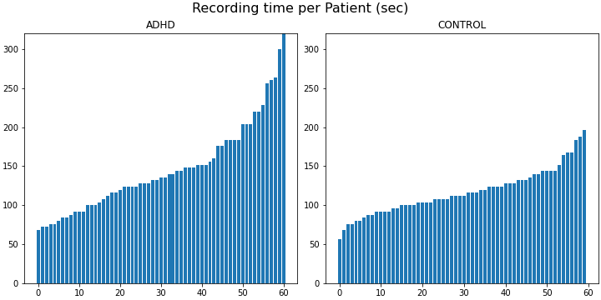
Data Collection
IEEE Dataport
60 ADHD recordings, 60 Control group recordings
Boys and girls, ages 7-12
128 Hz, 90~200 seconds per recording
19 channels

Slide 10
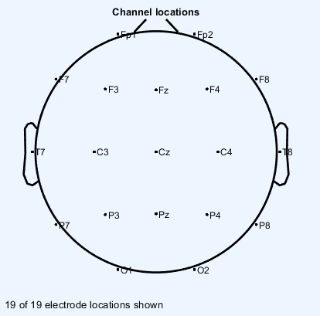
Data Collection
IEEE Dataport
61 ADHD recordings, 60 Control group recordings
128 Hz, 90~200 seconds per recording
Ex) 90 sec recording-> 90*128=11520 values
19 channels

Slide 11
Preprocessing
EEGLAB (Delorme & Makeig, 2004) is a widely used EEG processing tool
Built on MATLAB
EPOS is an EEG preprocessing pipeline (Rodrigues et al.)
Built using EEGLAB

Slide 12
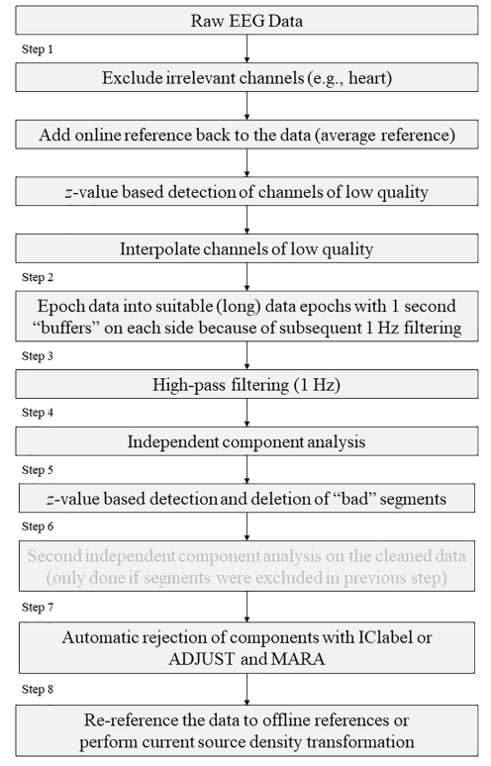
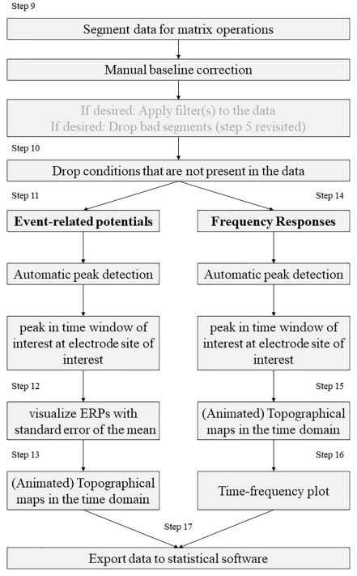

Slide 13
Notes:
Yannick Roy et al. showed that most of DL models did not use extracted features but rather raw data with simple preprocessing. I followed the steps shown in the box for necessary preprocessing.

Slide 14
Not necessary – No heart signal recorded

Slide 15
Average Reference
Create a new channel which contains average value of all channels
This is used for rejecting bad segments (epochs)

Slide 16
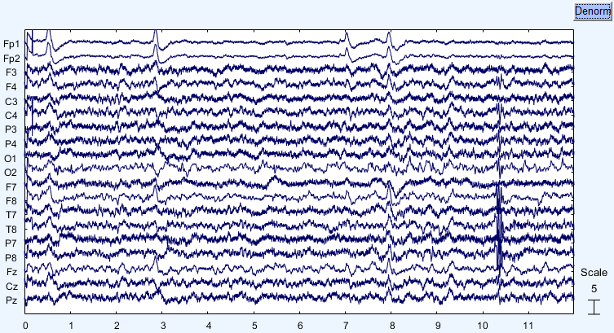
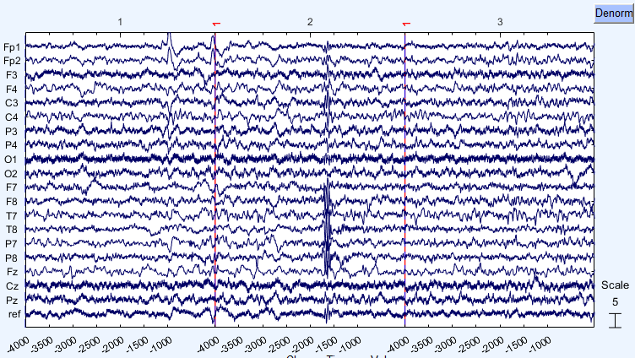
Method - Preprocessing
<Raw EEG signal>
<Preprocessed EEG signal>
Notes:
Add reference channel

Slide 17
Z-test rejection
Use statistical inference with calculated average to reject a channel with bad quality.
(probability > 3.29)

Slide 18
Interpolate rejected channels
Use channels around the bad channel to interpolate the values. (Spherical Interpolation)

Slide 19
Epoch 4 second window. 0 second overlap

Slide 20
High pass filtering
All frequencies below the target frequency will be dampened
Used for stable ICA results

Slide 21
Independent Component Analysis
“ICA separates the actual electronic brain signal from non-brain artifacts such as eye movements or muscle activity.”

Slide 22
Method - Preprocessing
<Raw EEG signal>
<Preprocessed EEG signal>

Slide 23
Method - Preprocessing
<Raw EEG signal>
<Preprocessed EEG signal>
Notes:
Epoch data

Slide 24
Method - Preprocessing
<Raw EEG signal>
<Preprocessed EEG signal>
Notes:
Rejected epoch

Slide 25
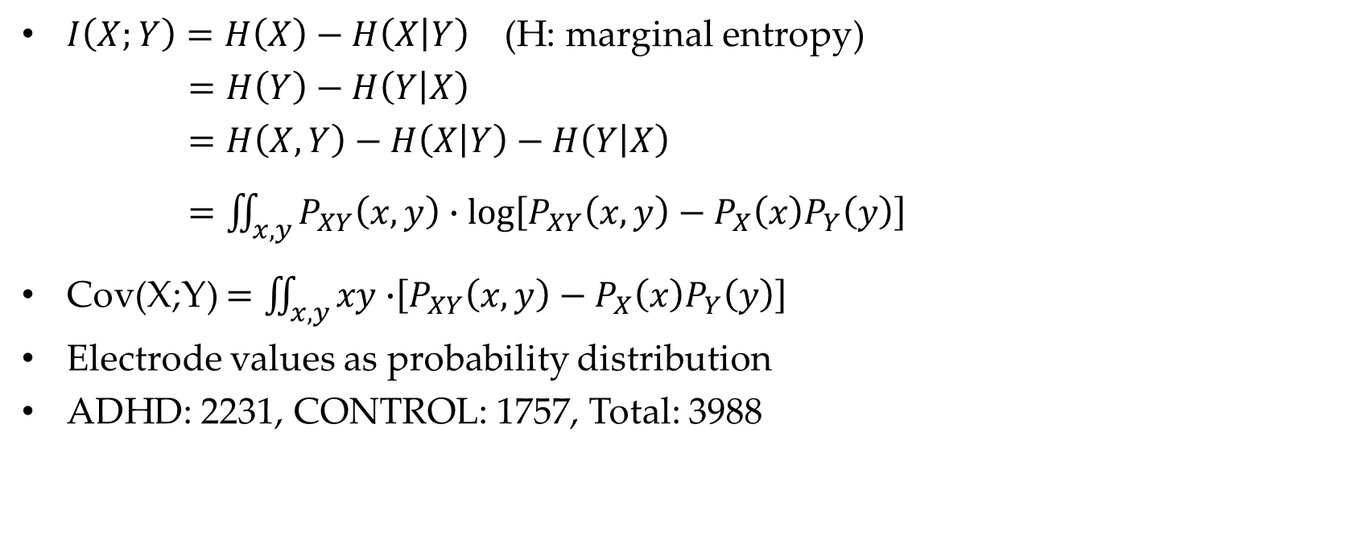
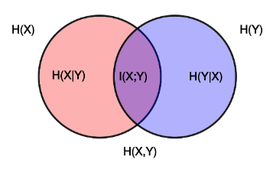
Create Mutual Information Table

Slide 26
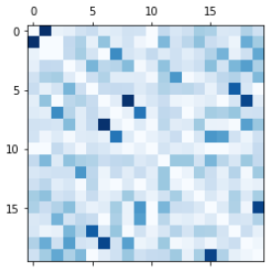
Create Mutual Information Table

Slide 27
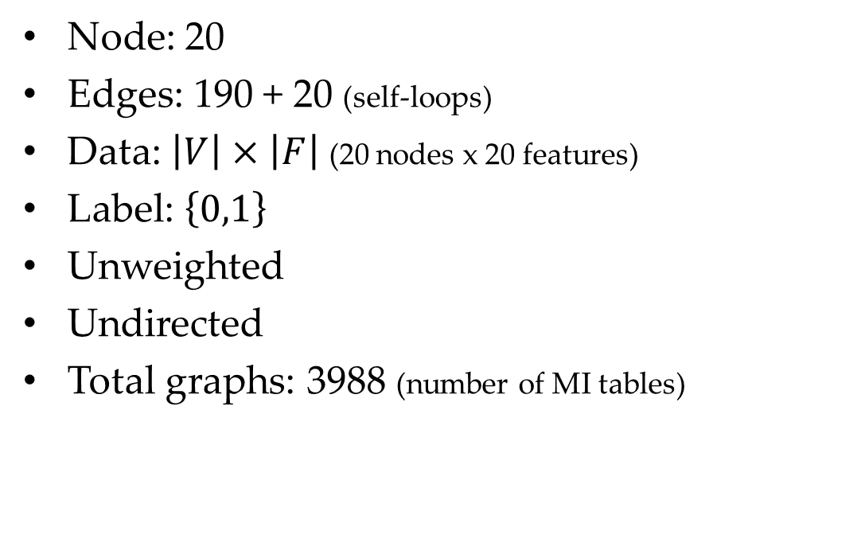
Create Graph Dataset

Slide 28
Create Graph Dataset

Slide 29
Create Graph Dataset

Slide 30
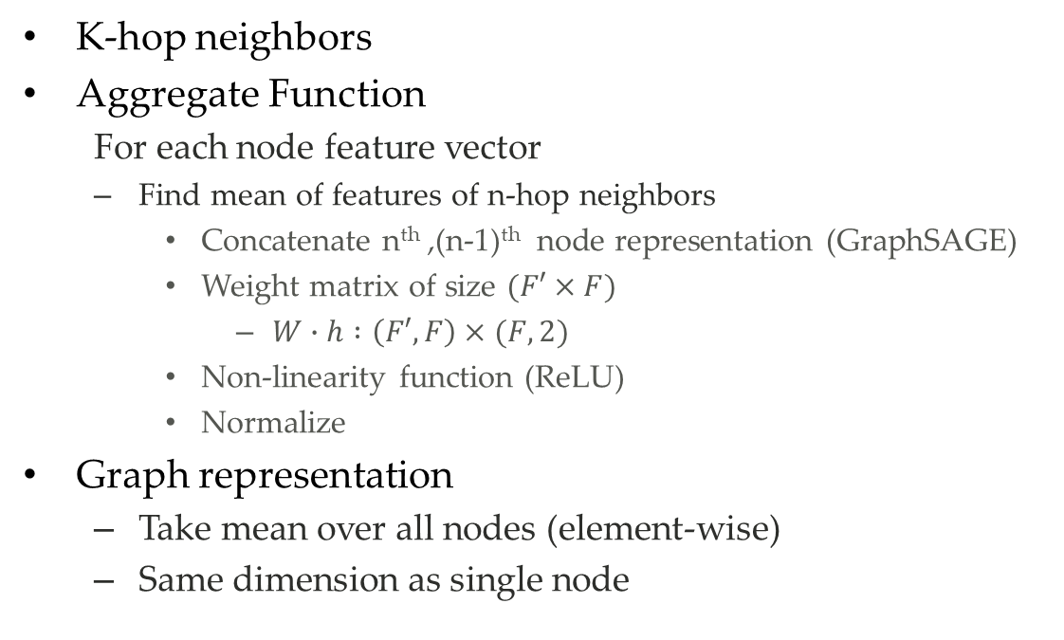
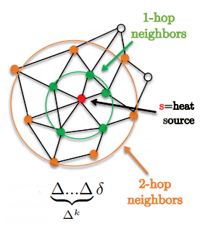
GNN Model

Slide 31
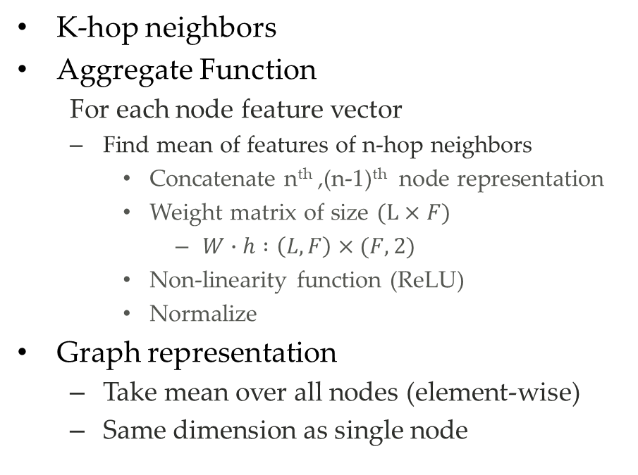
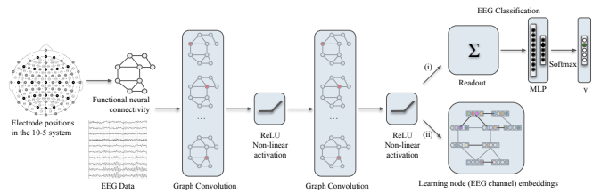
GNN Model

Slide 32
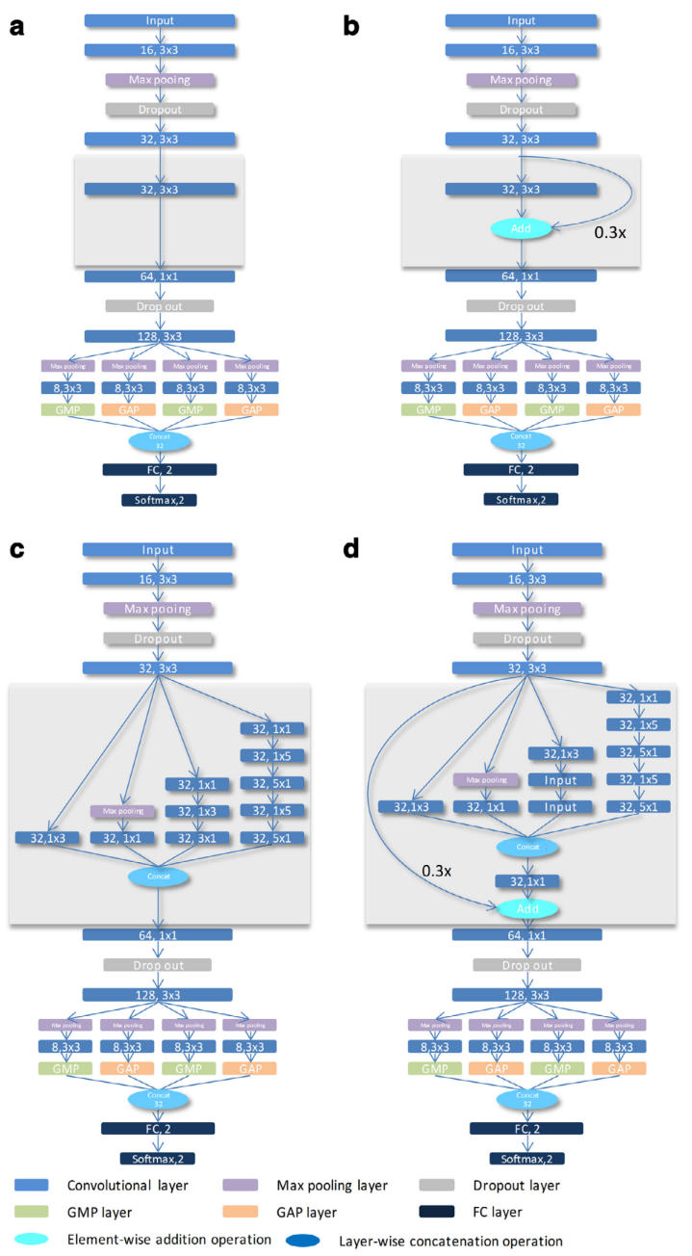
Replicate CNN
Chen et al. used a different dataset.
Number of patients
Number of electrodes
Best performing model from 4 proposed models

Slide 33
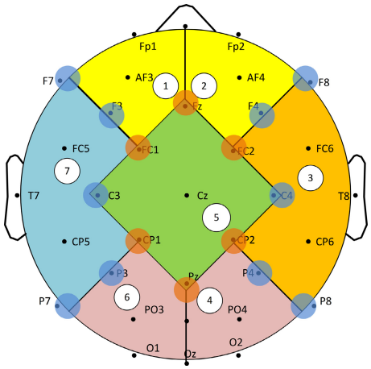
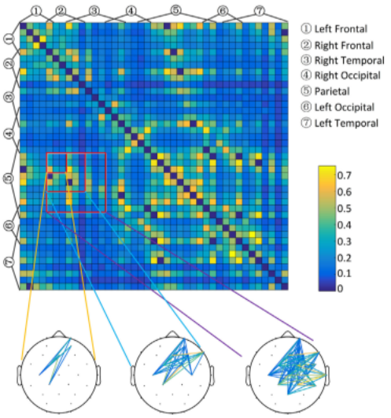
Replicate CNN

Slide 34
Replicate CNN
Group Electrodes

Slide 35
Replicate CNN
Left Frontal
Right Frontal
Right Temporal
Parietal
Left Occipital
Left Temporal
1
2
7
5
3
6
4

Slide 36
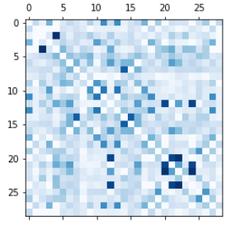
Replicate CNN

Slide 37
Replicate CNN

Slide 38
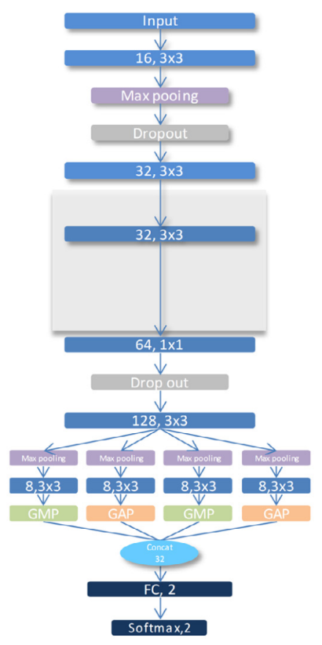
Replicate CNN

Slide 39
Conclusion
DIFF
K-hop | 1 | 2 | 3 | 4
Train | 81.09 | 81.98 | 85.59 | 86.35
Validation | 80.15 | 84.67 | 85.46 | 89.47
Test | 81.59 | 82.85 | 85.68 | 87.14
GCN
K-hop | 1 | 2 | 3 | 4
Train | 76.91 | 82.81 | 90.28 | 90.84
Validation | 76.13 | 84.42 | 88.44 | 89.95
Test | 75.53 | 81.92 | 89.92 | 90.25
SAGE
K-hop | 1 | 2 | 3 | 4
Train | 82.26 | 95.52 | 98.22 | 98.86
Validation | 82.91 | 92.46 | 96.48 | 96.98
Test | 82.05 | 95.46 | 97.97 | 98.65
CNN
Train | 99.33
Validation | 100
Test | 94.21

Slide 40
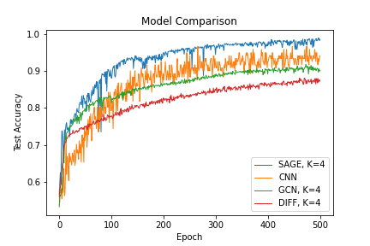
Conclusion
DIFF
K-hop | 1 | 2 | 3 | 4
Train | 81.09 | 81.98 | 85.59 | 86.35
Validation | 80.15 | 84.67 | 85.46 | 89.47
Test | 81.59 | 82.85 | 85.68 | 87.14
GCN
K-hop | 1 | 2 | 3 | 4
Train | 76.91 | 82.81 | 90.28 | 90.84
Validation | 76.13 | 84.42 | 88.44 | 89.95
Test | 75.53 | 81.92 | 89.92 | 90.25
SAGE
K-hop | 1 | 2 | 3 | 4
Train | 82.26 | 95.52 | 98.22 | 98.86
Validation | 82.91 | 92.46 | 96.48 | 96.98
Test | 82.05 | 95.46 | 97.97 | 98.65
CNN
Train | 99.33
Validation | 100
Test | 94.21

Slide 41
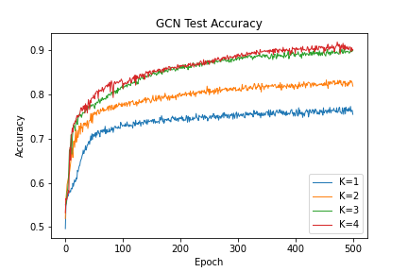
Conclusion
DIFF
K-hop | 1 | 2 | 3 | 4
Train | 81.09 | 81.98 | 85.59 | 86.35
Validation | 80.15 | 84.67 | 85.46 | 89.47
Test | 81.59 | 82.85 | 85.68 | 87.14
GCN
K-hop | 1 | 2 | 3 | 4
Train | 76.91 | 82.81 | 90.28 | 90.84
Validation | 76.13 | 84.42 | 88.44 | 89.95
Test | 75.53 | 81.92 | 89.92 | 90.25
SAGE
K-hop | 1 | 2 | 3 | 4
Train | 82.26 | 95.52 | 98.22 | 98.86
Validation | 82.91 | 92.46 | 96.48 | 96.98
Test | 82.05 | 95.46 | 97.97 | 98.65
CNN
Train | 99.33
Validation | 100
Test | 94.21

Slide 42
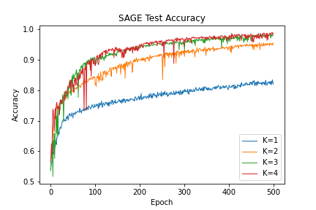
Conclusion
DIFF
K-hop | 1 | 2 | 3 | 4
Train | 81.09 | 81.98 | 85.59 | 86.35
Validation | 80.15 | 84.67 | 85.46 | 89.47
Test | 81.59 | 82.85 | 85.68 | 87.14
GCN
K-hop | 1 | 2 | 3 | 4
Train | 76.91 | 82.81 | 90.28 | 90.84
Validation | 76.13 | 84.42 | 88.44 | 89.95
Test | 75.53 | 81.92 | 89.92 | 90.25
SAGE
K-hop | 1 | 2 | 3 | 4
Train | 82.26 | 95.52 | 98.22 | 98.86
Validation | 82.91 | 92.46 | 96.48 | 96.98
Test | 82.05 | 95.46 | 97.97 | 98.65
CNN
Train | 99.33
Validation | 100
Test | 94.21

Slide 43
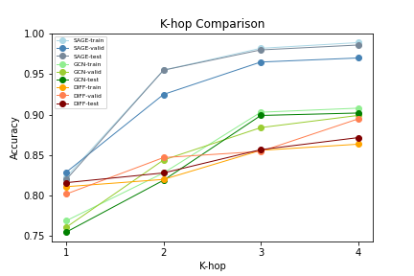
Conclusion
DIFF
K-hop | 1 | 2 | 3 | 4
Train | 81.09 | 81.98 | 85.59 | 86.35
Validation | 80.15 | 84.67 | 85.46 | 89.47
Test | 81.59 | 82.85 | 85.68 | 87.14
GCN
K-hop | 1 | 2 | 3 | 4
Train | 76.91 | 82.81 | 90.28 | 90.84
Validation | 76.13 | 84.42 | 88.44 | 89.95
Test | 75.53 | 81.92 | 89.92 | 90.25
SAGE
K-hop | 1 | 2 | 3 | 4
Train | 82.26 | 95.52 | 98.22 | 98.86
Validation | 82.91 | 92.46 | 96.48 | 96.98
Test | 82.05 | 95.46 | 97.97 | 98.65
CNN
Train | 99.33
Validation | 100
Test | 94.21

Slide 44
Conclusion
GCN, DIFF did not outperform CNN.
“The majority of these methods do not scale to large graphs or are designed for whole-graph classification.” (Hamilton et al.)
SAGE outperformed CNN.
More suitable for brain-signal research
Accuracy Increased for bigger K value
Brain stimulation
Needs to be compared with neuroscience literature

Slide 45
Further Research Direction
Other methods to construct adjacency table
Pearson Correlation
Dynamic Time Warping
Other GNN models
Graph Isomorphism Network, SortPool, EdgePool, SagPool
BrainGNN, SGCN
Compare with literature on ADHD research in neuroscience
Interpretable Machine Learning

Slide 46
Thank You

Slide 47
Questions / Suggestions

